Slide 1
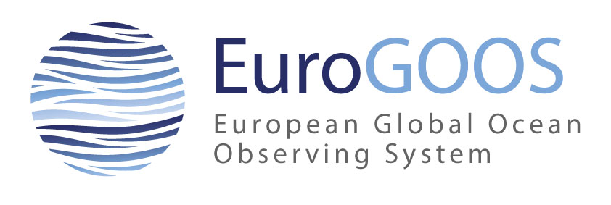
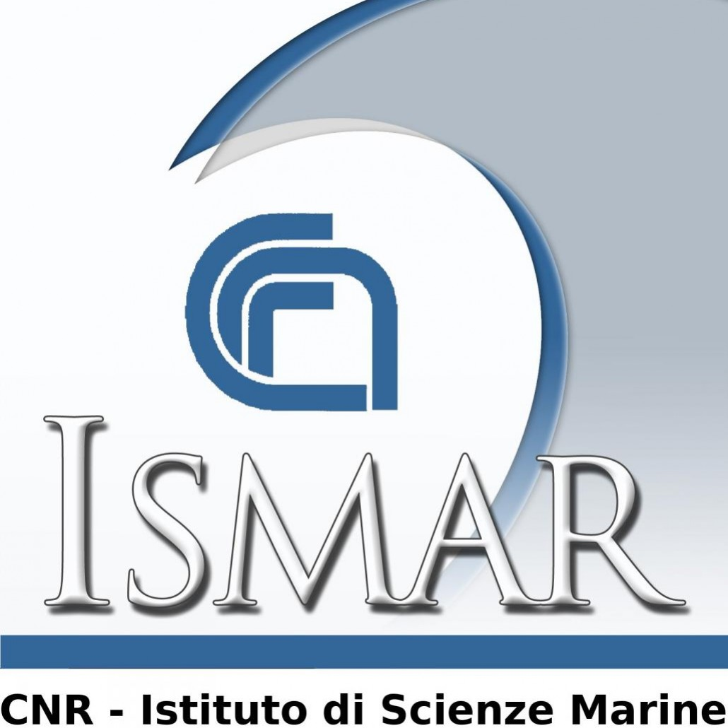
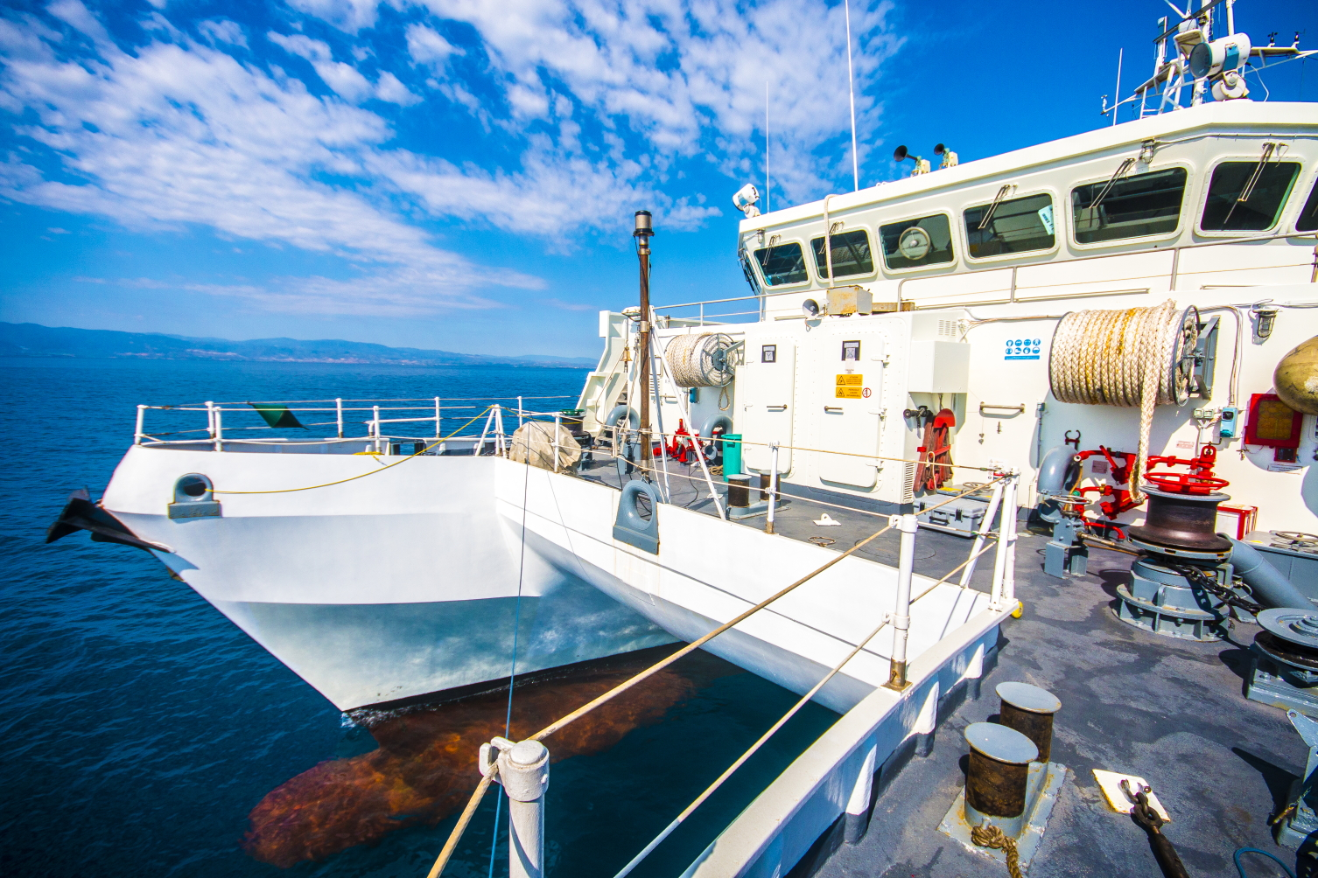
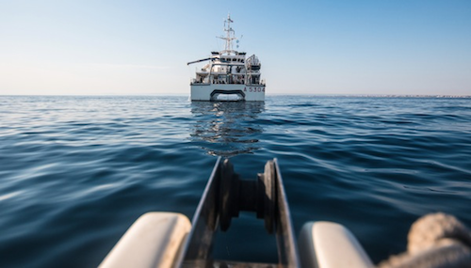
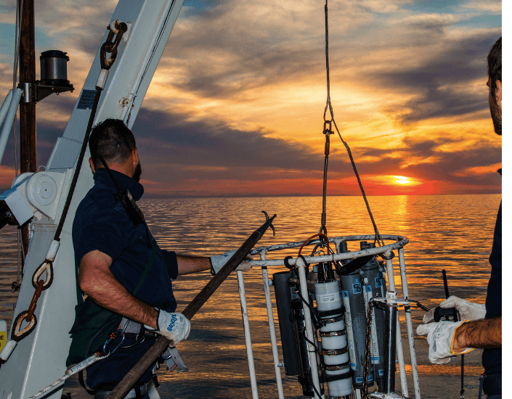
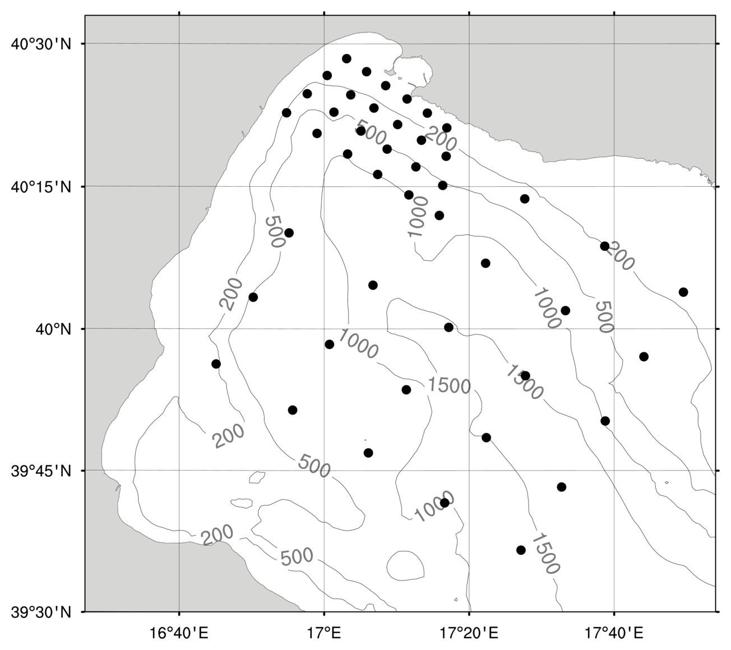
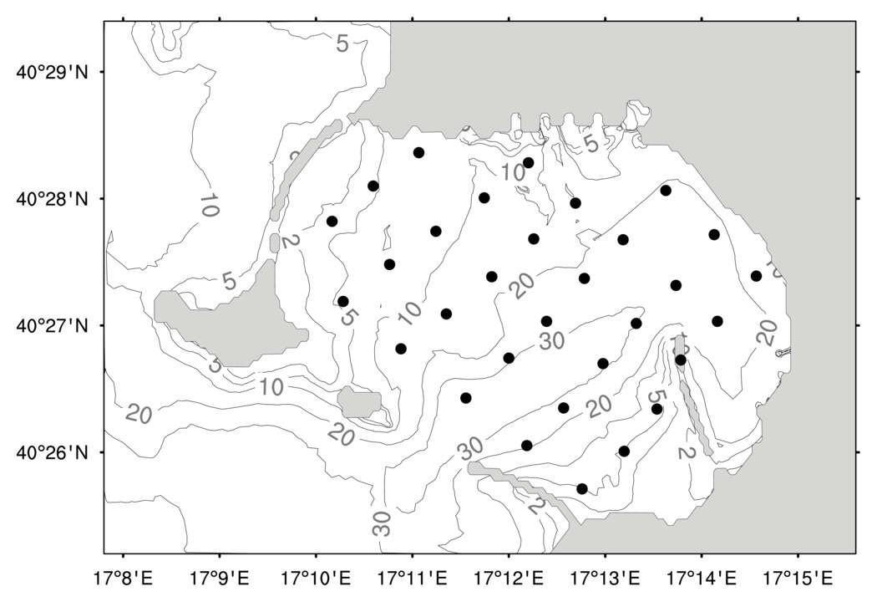
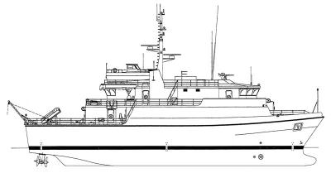
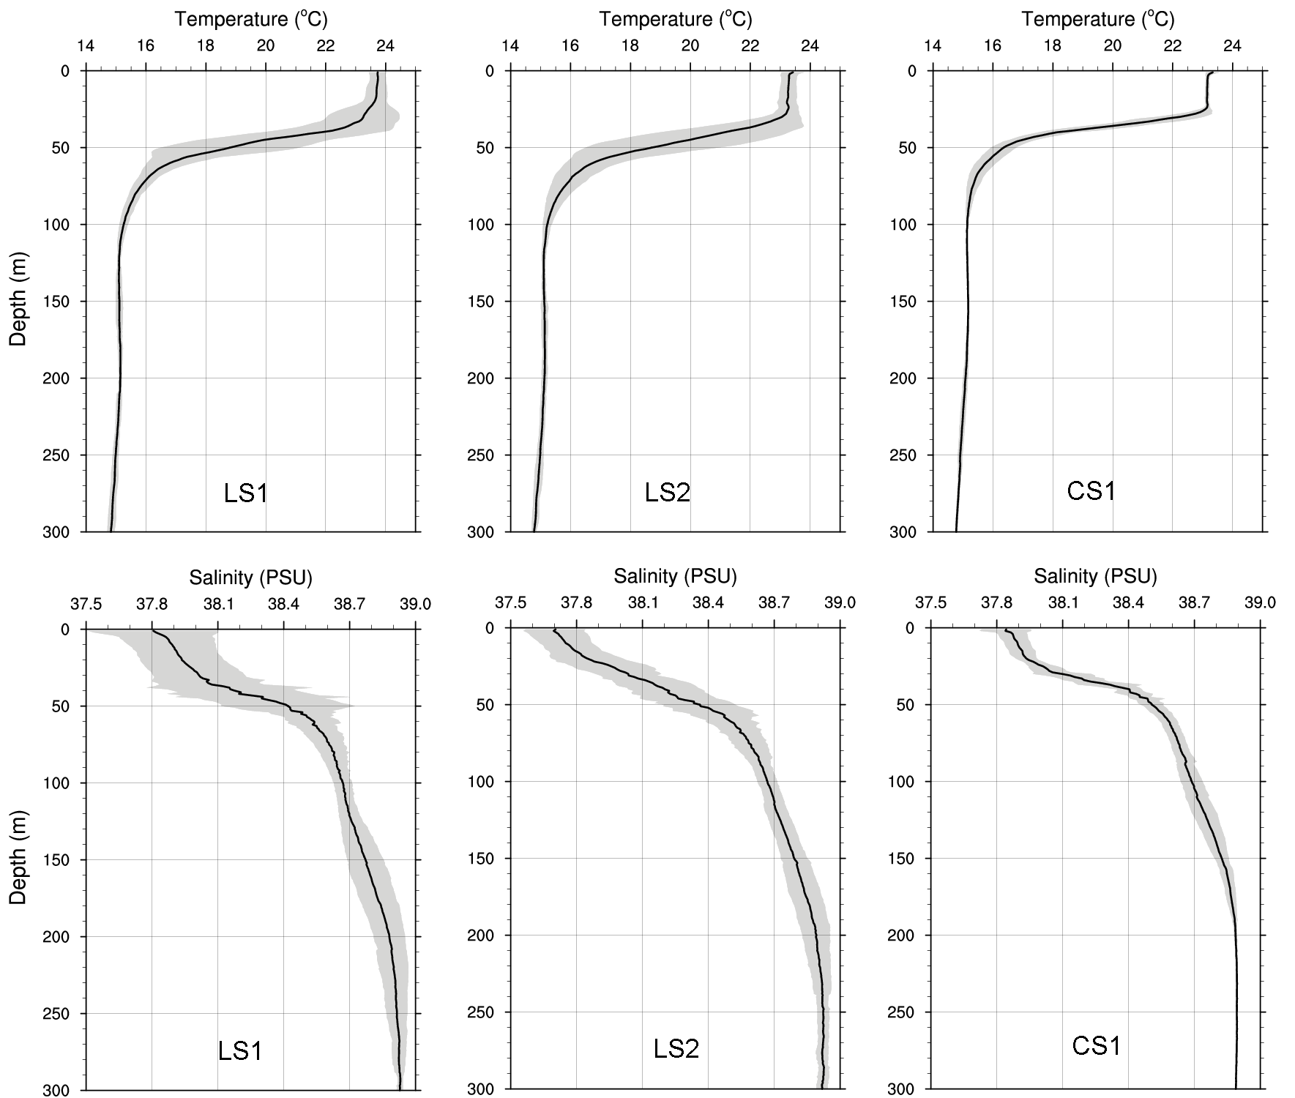
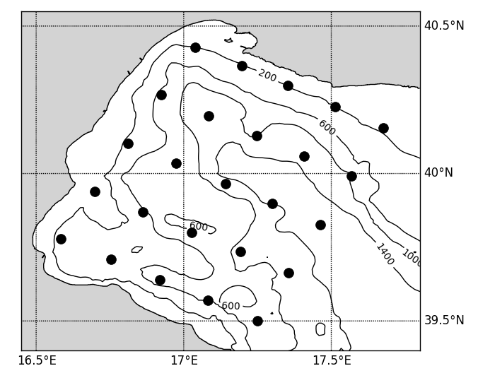
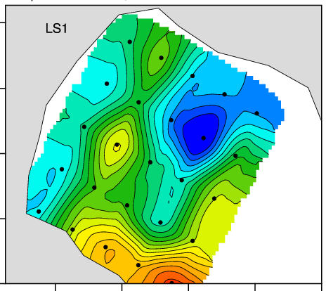
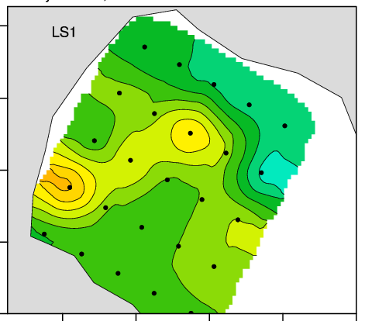
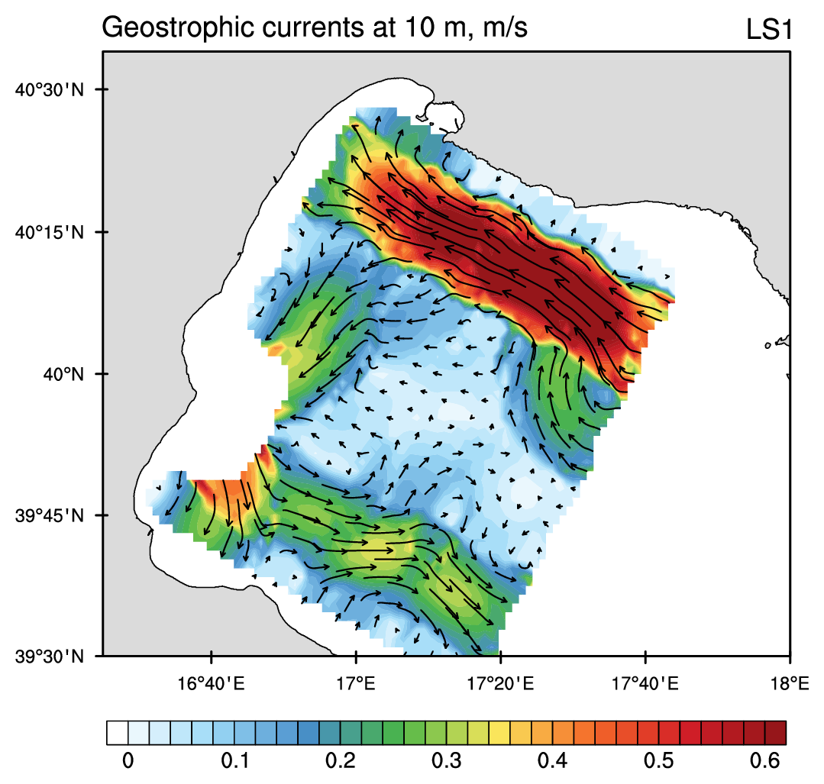
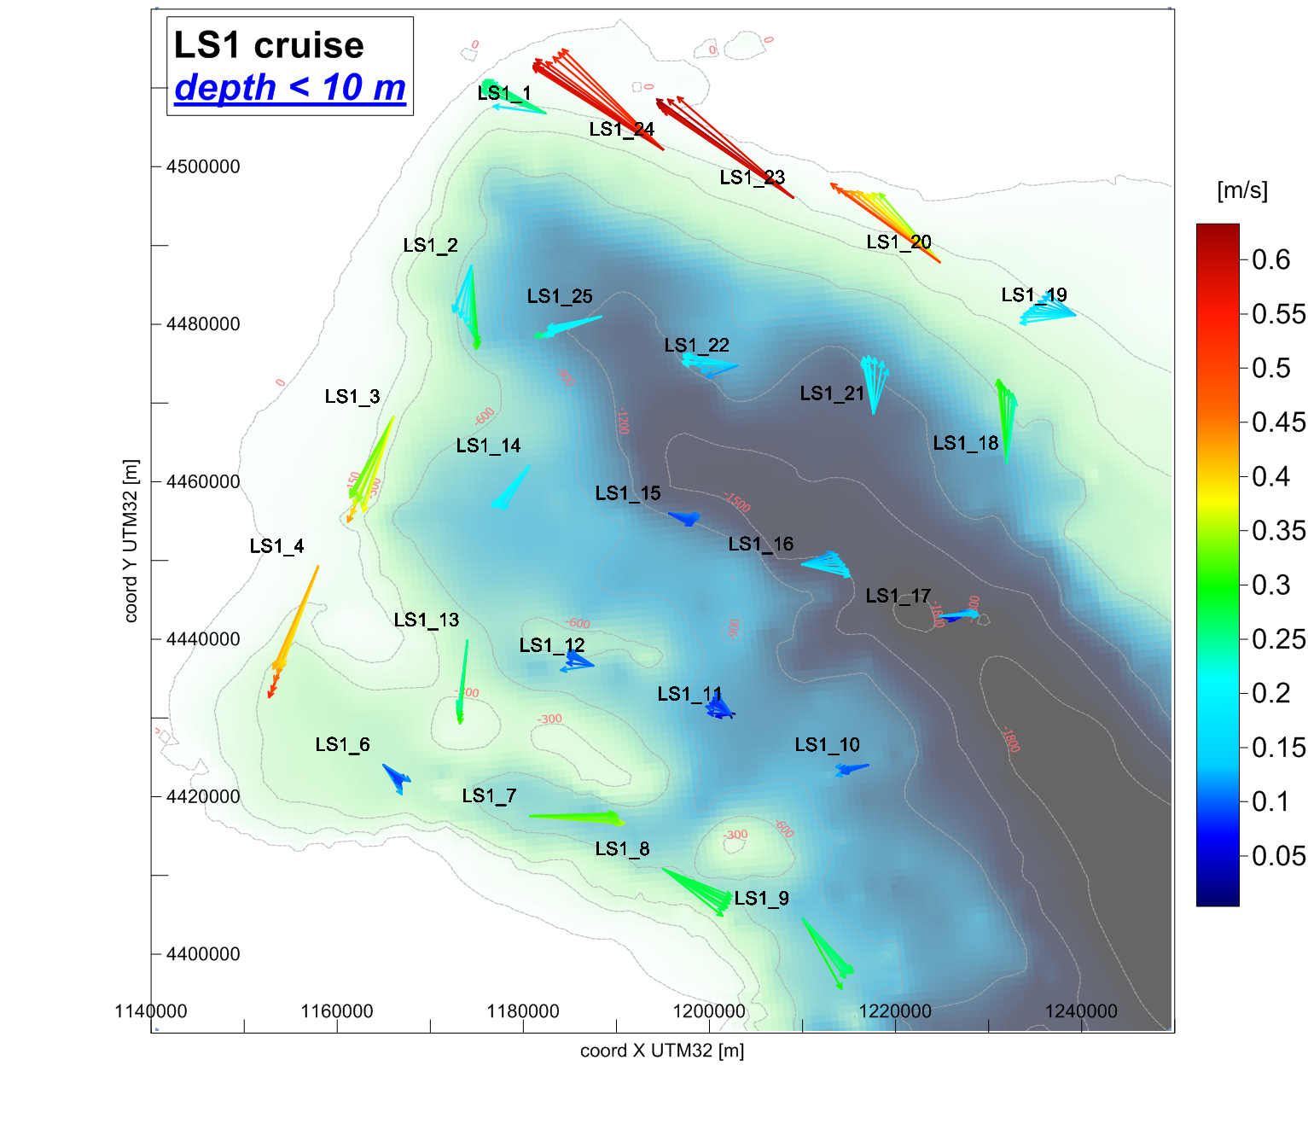
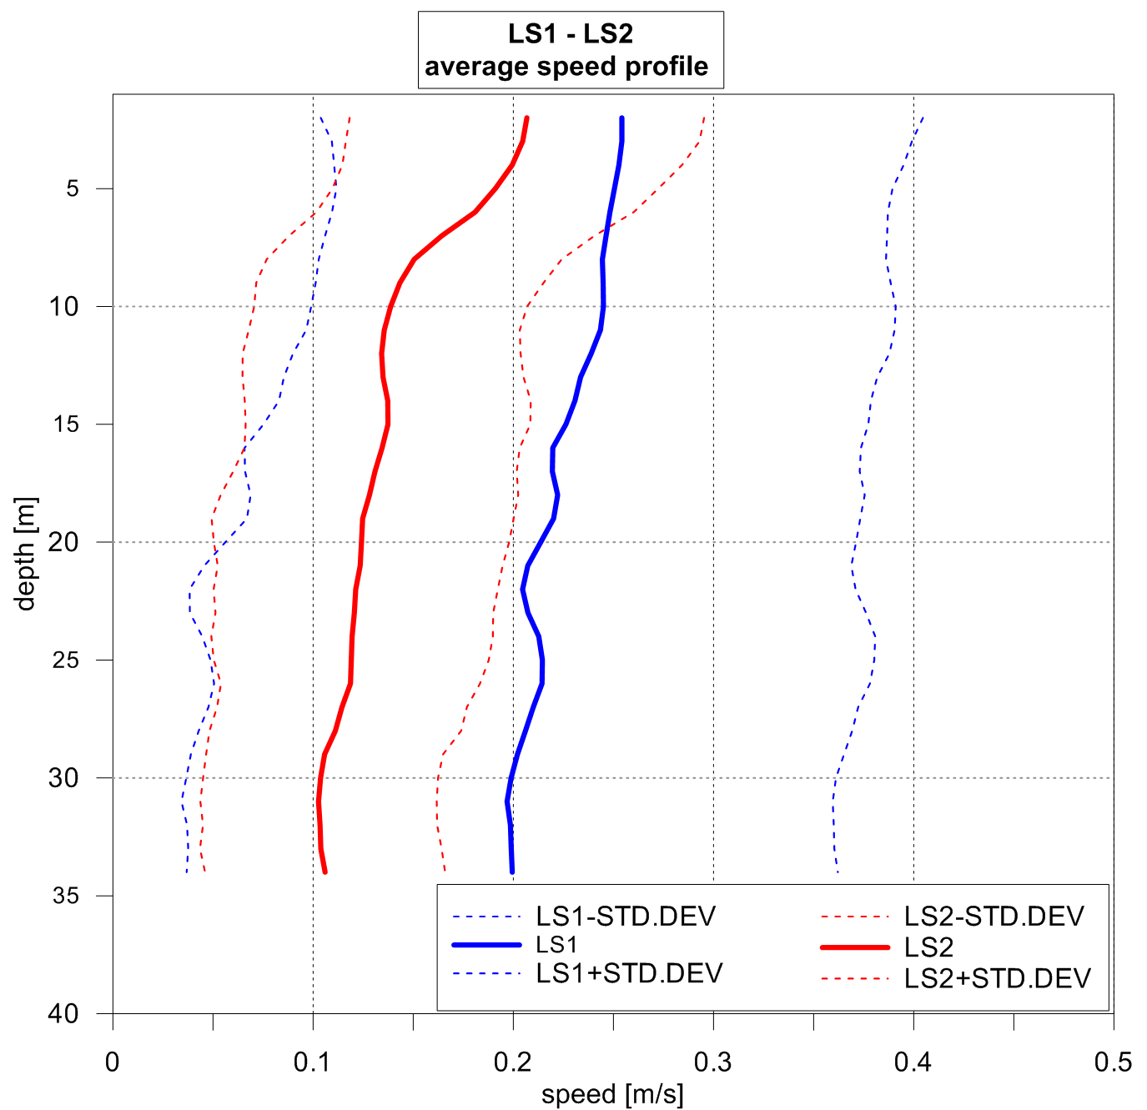
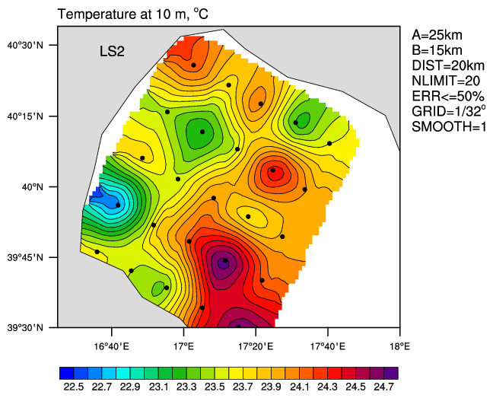
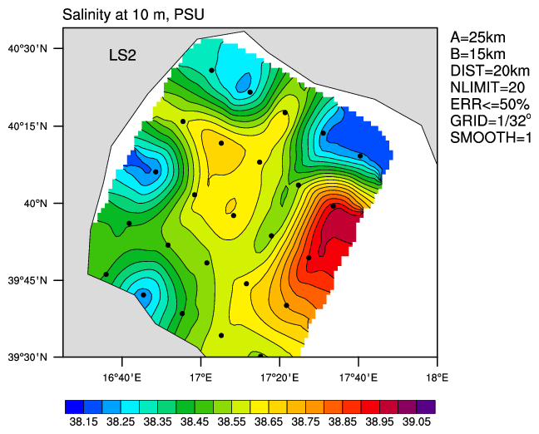
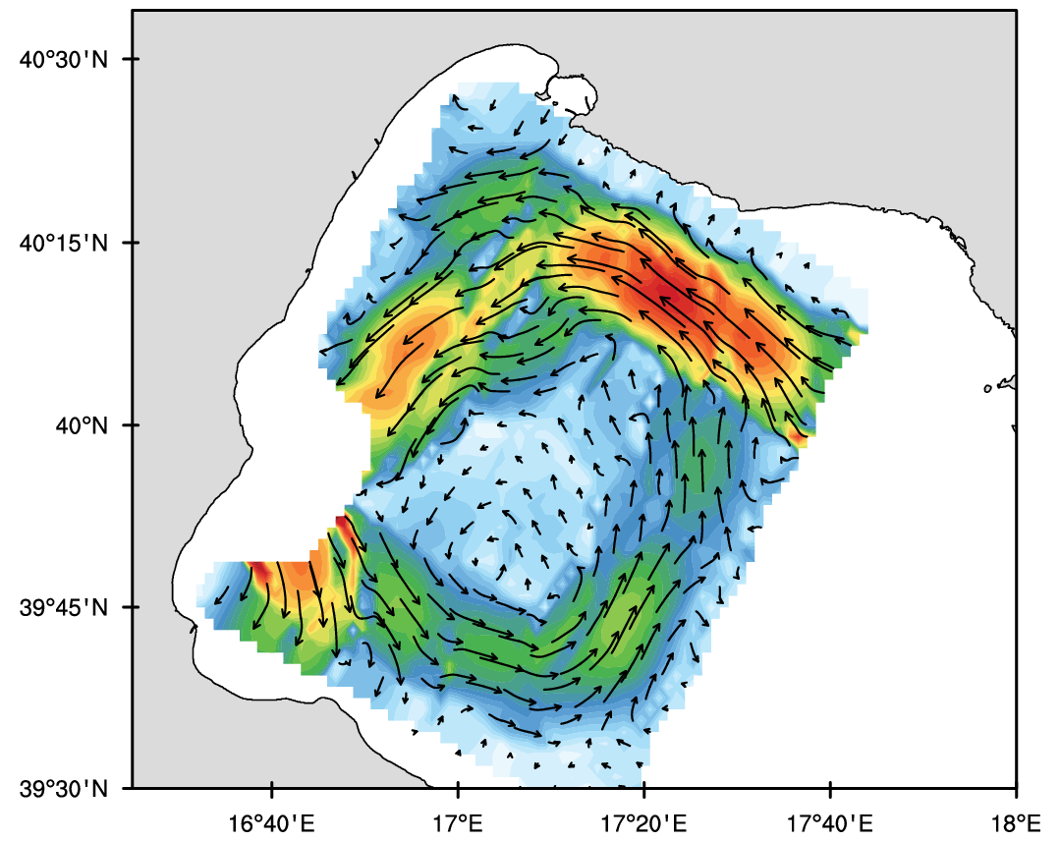
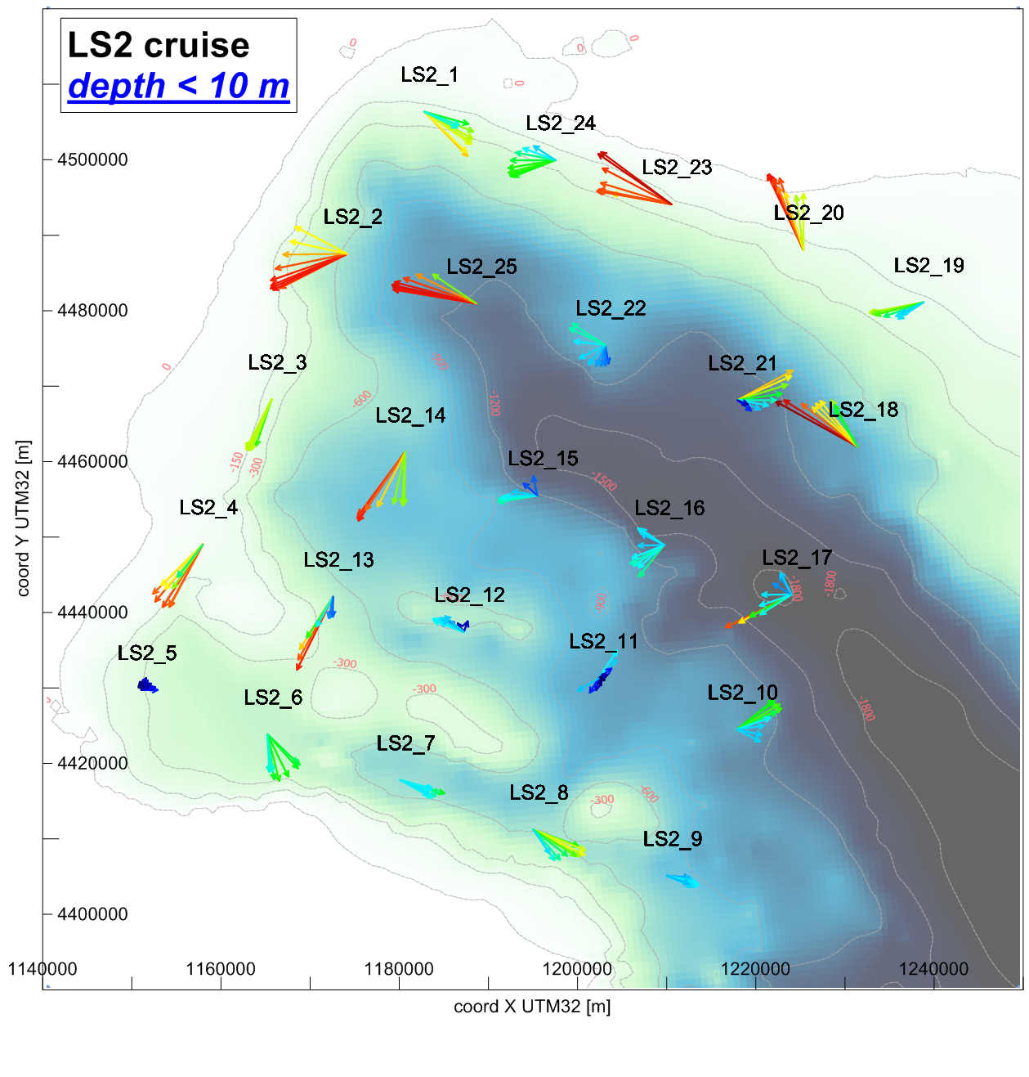
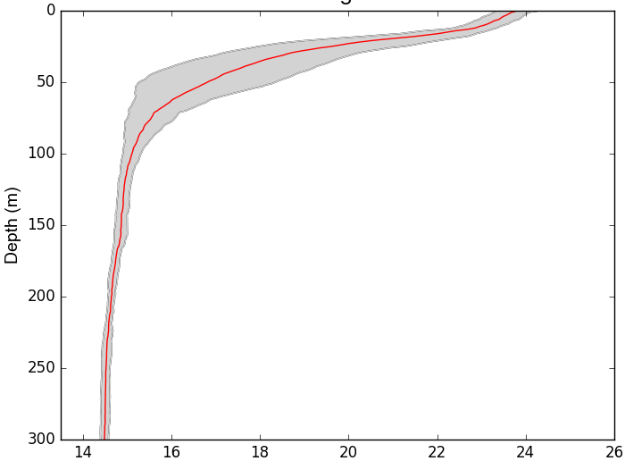
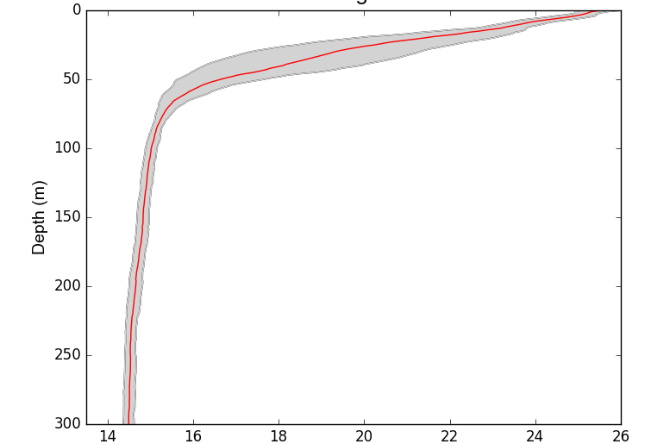
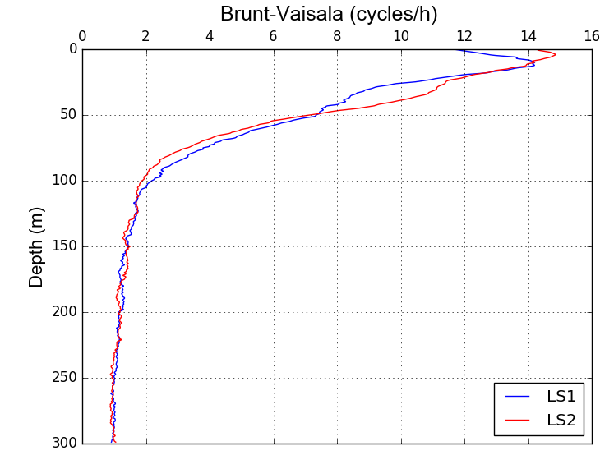
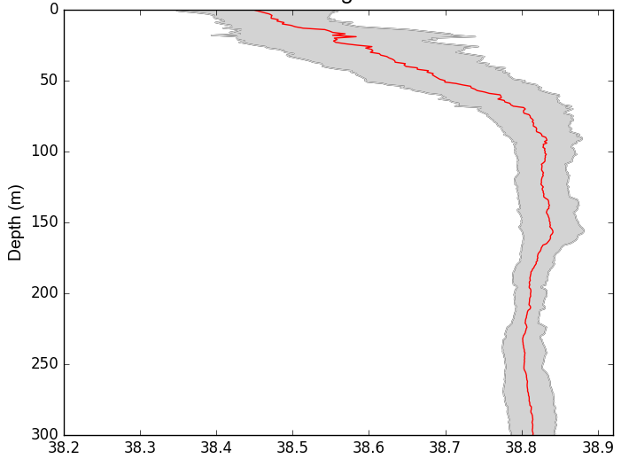
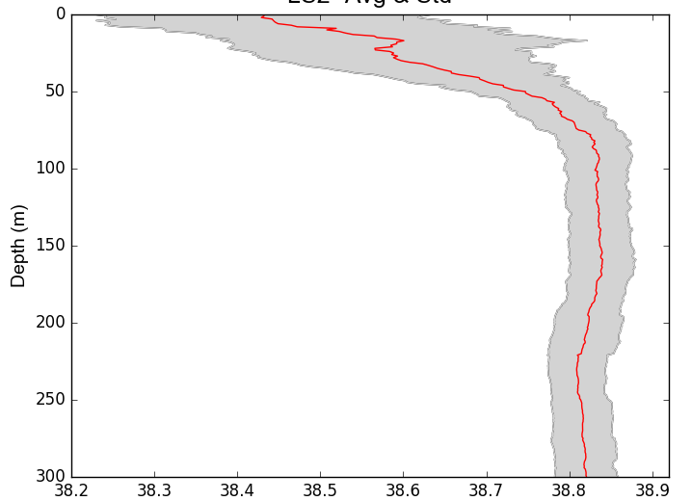
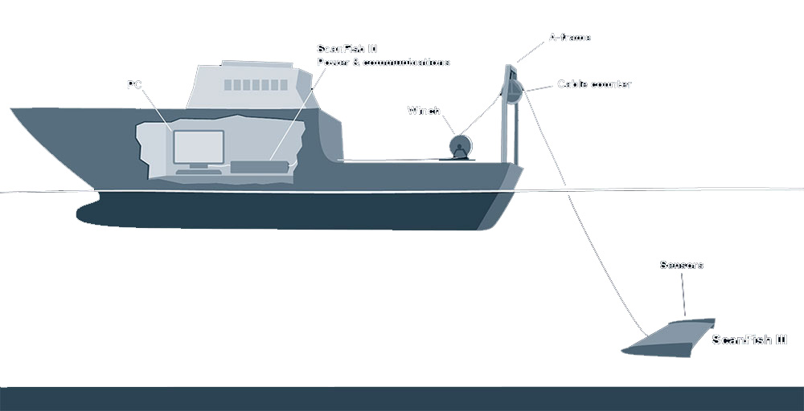
Multiscale and multidisciplinary Marine Rapid Environmental Assessment data collection methodology for operational and forecasting oceanography
I. Federico⁽¹⁾, F. Maicu⁽²⁾, N. Pinardi^{(1,3)}, P. Oddo⁽⁴⁾, M. Zavatarelli⁽³⁾, V. Lyubartsev⁽¹⁾, S. Causio⁽¹⁾, C. Caporale⁽⁵⁾, M. Demarte⁽⁵⁾, A. Falconieri⁽⁶⁾, R. Lecci⁽¹⁾, T. Lacava⁽⁶⁾, M. Lisi⁽³⁾, A. Sepp-Neves⁽³⁾, G. Lorenzetti⁽²⁾, G. Manfè⁽²⁾, F. Trotta⁽³⁾, L. Zaggia⁽²⁾, S. A. Ciliberti⁽¹⁾, C. Fratianni⁽⁷⁾, A. Grandi⁽⁷⁾
⁽¹⁾ Centro Euro-Mediterraneo sui Cambiamenti Climatici (CMCC) Lecce, Italy
⁽²⁾ Istituto di Scienze Marine, CNR, Venezia, Italy
⁽³⁾ Department of Physics and Astronomy, University of Bologna, Bologna, Italy
⁽⁴⁾ Centre for Maritime Research and Experimentation (CMRE), La Spezia, Italy
⁽⁵⁾ Istituto Idrografico della Marina Militare Italiana, Genova, Italy
⁽⁶⁾ Istituto di Metodologie per l’Analisi Ambientale, CNR, Potenza, Italy
⁽⁷⁾ Istituto Nazionale di Geofisica e Vulcanologia (INGV), Bologna, Italy
Abstract
The work provides an overview on MREA (Marine Rapid Environmental Assessment) experimental and observational methodology developed in the last years, thanks to the synergies between several multi-disciplinary oceanographic research centers and the Italian Navy Hydrographic Institute.
The approach is based on an optimal strategy (i) to collect evidences on ocean mesoscales and submesoscales with a spatial-and-time synoptic coverage and repeated surveys, (ii) to increase the skills of ocean forecasting, producing both initialization and verification datasets for numerical models.
What is MREA?
State-of-art
The Italian MREA experiments
The Marine Rapid Environmental Assessment is a methodology to collect marine data useful to improve our knowledge of the marine state and specific dynamical processes and increase skill of ocean forecasting and analyses.
It was developed in the late 1990s to collect synoptic oceanographic data relevant for nowcasts, forecasts and derived applications by Robinson and Sellschopp (2002).
Data collection and analysis has to be developed which considers synoptic time scales and repeated surveys to produce both initialization and verification data sets.
MREA is one of the optimal experimental strategies to collect definitive evidence on ocean mesoscales for improving knowledge and forecast skill.
The Italian MREA experiments were thought to contribute to:
The historical Rapid Environment Assessment surveys in Mediterranean Sea
Western Mediterranean
the definitive set up of a rapid CTD and ADCP collection strategy in different regions of the Italian marine EEZ and other areas of particular strategic interest;
the study of surface and near surface processes that couple waves and currents, physical and biochemical processes, from the coastal to the open ocean.
demonstrate and validate the numerical model downscaling from large scale operational and forecasting oceanography products.
Starting from the experiences of the so-called REA (Rapid Environmental Assessment) implementations in Mediterranean areas in late 1990s (Robinson and Sellschopp, 2002), here we illustrate our three MREA strategies, progressively improved and adapted to the physical processes to be investigated.
Ligurian Sea
MREA07-08-17
Fabbroni et al., 2008 (GNOO)
Northern Ionian
“The concept of Rapid Environmental Assessment (REA) is to provide environmental nowcasts and forecasts accurate and efficient enough to support operational activity in any arbitrary region of the global coastal ocean, and to respond to operational assessment requests effectively on very short notice. Ocean science and technology today are rapidly evolving and recognized as generally involving interdisciplinary processes and interactions on multiple scales in space and time” (Robinson et al., 1999).
Gulf of Taranto
MREA14-16
MREA website
mrea.sincem.unibo.it
MREA14 – Gulf of Taranto (October 2014)
Pinardi et al., 2016:
Nat. Hazards Earth Syst. Sci., 16, 2623-2639, 2016
Companion papers on modelling
The sampling strategy
Period: 1-10 October 2014
MG1
Shelf-coastal-harbour scale surveys (MG1)
Average 15m deep
Shelf-coastal area of the Mar Grande (heavily human impacted harbor area)
Mean station distance: 1km
Measurements
Objective analysis on T/S and geostrophic currents
CS1
Shelf-coastal scale surveys (CS1)
Average 400m deep
Mean station distance: 5km
5 Oct 2014
1km spacing
Federico et al., 2017: Coastal ocean forecasting with an unstructured grid model in the southern Adriatic and northern Ionian seas, , Nat. Hazards Earth Syst. Sci., 17, 45-59, doi:10.5194/nhess-17-45-2017. Keywords: Operational forecasting system, unstructured-grid modelling, Downscaling
Gaeta et al., 2016: A coupled wave–3-D hydrodynamics model of the Taranto Sea (Italy): a multiple-nesting approach, Nat. Hazards Earth Syst. Sci., 16, 2071-2083, doi:10.5194/nhess-16-2071-2016. Keywords: Multiple nesting, wave-currents coupling, harbour scale
Trotta et al., 2017: Multi-nest high resolution model of submesoscale circulation features in the Gulf of Taranto, subm. Ocean Dynamics, 2017 Keywords: Relocatable ocean model, multiple nesting, submesoscale
8 Oct 2014
(5km spacing)
Oceanographic cruises:
CTD Idronaut 316Plus
on board of the RV Galatea for LS1, CS1 and LS2.
Temperature (10m)
Salinity (10m)
Geostrophic currents
LS1
1-3 Oct 2014
9-11 Oct 2014
(16km spacing)
LS1: surface currents, turning clockwise around the anticyclonic gyre, are characterized by jets, i.e., intensified rim current segments.
LS2
Large scale surveys (LS1 and LS2)
Quasi-synoptic timescale
Average 800m deep
Repetition of stations in LS2 (large-scale changes on a weekly basis)
Mean station distance: 16km (~Rossby radius of deformation for the EastMed)
C2
C3
Thermohaline structures
CTD
C1
F1
F1
Average temperature and salinity profiles, and standard deviation
Weather conditions
Area average precipitation and 10m wind magnitude (COSMOME model)
The weather conditions deteriorated after 4 October and large winds developed on 5 October while precipitation started 3 October and continued until 5 October.
UP
UP
LS2+CS1: meandering rim current → baroclinic–barotropic instability and eddy growth. Submesoscale structure.
60 m: middle of the surface thermocline
Four water masses can be detected.
Surface water mass: low salinity and almost constant temperature).
Thermocline water type: mixing of the surface waters and MLIW;
MLIW type: salinity and temperature increase with respect to the (2).
Deep water mass type: temperatures lower than 14°C and relatively low salinities, probably of Adriatic origin.
C4
LIW
Difference in T and S
Impact of precipitation.
Changes in a 1-week period (between LS1 and LS2) in the first 100m of the water column
LS2 colder and fresher than LS1 (-0.5°C and -0.1 PSU)
LS2 mixed layer depth decreased by about 5 m, leading to a 0.8°C difference in temperature at 40m.
Typical end-of-summer stratification of temperature in the eastern Mediterranean (mixed layer down to 30m and a seasonal thermocline with a temperature gradient of about 10°C)
Modified Levantine Intermediate Water (MLIW): between 100 and 300m → subsurface salinity maximum.
Upper mixed layer temperature and salinity mapping.
LS1: frontal structure (F1). Cold core eddies (C1, C2 and C3) are present north of the frontal structure.
LS2: Disappear F1. Smaller eddies formed. Cyclonic eddy (C4)
Temperature diff (LS2-LS1) - °C
Salinity diff (LS2-LS1) - PSU
Reversal of large-scale circulation
in Gulf of Taranto
in certain periods of the year
From anticyclonically-oriented in Autumn (MREA14) and cyclonically-oriented in Summer (MREA16)
MREA16 – Gulf of Taranto (June-July 2016)
The sampling strategy
Large scale surveys (LS1 and LS2).
Quasi-synoptic timescale
Average 800m deep
Repetition of stations in LS2 (large-scale changes on a weekly basis).
Increased mean station distance to cover the entire Gulf: 16÷20 km (~Rossby radius of deformation for the EastMed)
Measurements
Objective analysis on T/S and geostrophic currents
Surface currents (ADCP)
LS1
27-30 Jun 2016
LS2
4-7 Jul 2016
CG1
30 Jun - 1 Jul 2016
CG2
7-8 Jul 2016
Temperature (10m)
Salinity (10m)
Geostrophic currents
Surface currents
Velocity profile
(16-20km spacing)
Oceanographic cruises:
CTD Idronaut 316Plus
ADCP Teledyne RD Rio Grande 600 khz (installed between the ship hulls – catamaran)
on board of the RV Aretusa for LS1 and LS2, CG1 and CG2
LS1
LS1
LS1
LS1 depth: 0-10m
Period: 27 June - 7 July 2016
Daily cycle survey (CG1-CG2).
24 hours survey in the same station, repeated every 2 hours to detect internal waves and daily cycle of T/S
Sampling depth 160 m
CTD
ADCP
m/s
Thermohaline structures
LS2
LS2
LS2
LS2 depth: 0-10m
The analysis of the average (LS1, LS2) vertical current profiles confirms the weakening of the cyclonic circulation between LS1 and LS2 surveys
Average temperature and salinity profiles, and standard deviation
LS1
LS2
PSU
Temperature (°C)
Temperature (°C)
°C
m/s
The geostrophic circulation pattern derived from the CTD objective-analysis mapping techniques has been verified with the ADCP measurements
The analysis on circulation fields confirms the presence of possible submesoscale structures, which can be well solved by a high-resolution sampling scheme.
LS1
Salinity (PSU)
LS2
Salinity (PSU)
Brunt-Vaisala frequency:
Typical summer stratification: 8-15 cycles/h between 0-50m.
LS2 higher stratified than LS1 between 0-50m.
Increasing of temperature from LS1 to LS2
In LS2, warmer and saltier waters at the south-eastern corner. Incoming waters in the Gulf confines and closes the large-scale cyclonic gyre.
Fresher inputs in the coastal waters of Basilicata (Bradano and Basento rivers) and Calabria (Crati river) highlighted in LS2 (inland precipitations)
Salinity drop in LS2 due to precipitations (e.g. Porto Cesareo)
Basin scale cyclonic gyre
North-eastern front in LS1 strengthens coastal circulation stream
In LS2, in the shelves of Taranto: coastal anti-cyclonic gyre.
Possible formation of submesoscale structures (which can be well solved by a high-resolution sampling scheme)
1m meter submerged
1m vertical resolution
10 min profiling with ensambles every 5 sec.
Typical beginning-summer stratification of temperature in the eastern Mediterranean.
Increase of surface temperature from LS1 to LS2 and higher stratification
Variability in thermocline: higher variability for LS1
Local peak of salinity at 30 m
Changes in a 1-week period (between LS1 and LS2) in the first 110m of the water column
LS2 warmer (air temperature) than LS1 between 0-50m, and colder than LS1 between 50-100m. Surface: LS2-LS1=+1.5°C; -0.03 PSU (fresher: rain event).
MREA17 – Ligurian Sea (Sept-Oct 2017)
Concluding remarks
The sampling strategy
Measurements
The Marine Rapid Environmental Assessment methodology has been developed, progressively improved and refined with standard protocols for the on-board operations.
The sampling methodology has been strengthened in the last years integrating (i) the classical CTD data collection with additional simultaneous measurements of (ii) currents by means of vessel-mounted ADCP, (iii) optical properties of sea surface with radiometric surface measurements and (iv) underwater remotely operated towed ScanFish vehicles, equipped with CTD, oxygen and light sensors.
The methodology has been verified to be relocatable in different areas (Ligurian Sea and Gulf of Taranto), at multiple scales (from large- to meso- to submeso-scale).
The MREA data collections have allowed (i) supporting operational and forecasting oceanography (producing both initialization and validation datasets and increasing the the forecasting skills), and (ii) performing process study (e.g. the possible formations of sub-mesoscale structures, the reversal of circulation in certain periods of the year from anticyclonic to cyclonic in Gulf of Taranto).
The next campaigns planned in Autumn 2017 in the framework of LOGMEC experiment, leaded by CMRE, will investigate the submesoscale fields in Ligurian Sea (Western Mediterranean).
SM-2500
SM-500
The campaigns (SM-2500, SM-500 and SM-250) will adopt new approaches, consisting in use of sampling schemes with increasing spatial resolution.
The multiscale-multidisciplinary aspects are addressed combining remote sensed data with unmanned underwater vehicles and shipborne instrumentations equipped with multidisciplinary sensors. This will allow to capture possible submesoscale structures and simultaneously characterize the large scale dynamics.
Oceanographic cruises:
CTD Idronaut 316Plus
ADCP Teledyne RD Rio Grande 600 khz (installed between the ship hulls – catamaran)
on board of the RV Aretusa for SM-2500
SM-500
CTD
ADCP
SM-2500
25 Sept-02 Oct 2017
SM-hyb
SM-500
SM-hyb
SM-250
27-29 Sept 2017
SM-250
Oceanographic cruises:
ScanFish with sensors
- SBE 43 Dissolved Oxygen,
- ATLANTIC OCR 504 - 2 CTD pumped
- ECO Puck
Surface radiometry (ASD FieldSpec)
on board of the CRV Leonardo for SM-500, SM-hyb and SM-250
Surface
Radiometry
25 Sept-02 Oct 2017
SM-250
Period: 25 Sept - 02 Oct 2017
ScanFish

